Slide 1
PCleaner
Swimming Pools Daily Care

Slide 2
Contents
Application
Conceptual Design
Mechanical
Actuator Sizing
Stability
Electrical System
Safety
Software Architecture
Manufacturing
Estimated Budget
Timeline

Slide 3
Application & User Interface
Swimming pool daily care mobile robot. Removes insects and dry leaves floating on water surface.
User connects a regular a socket to an AC power plug, place it in water, and presses the start button.

Slide 4
Conceptual Design
Minimizing Drag Force
Collecting rubbish by Water Suction

Slide 5
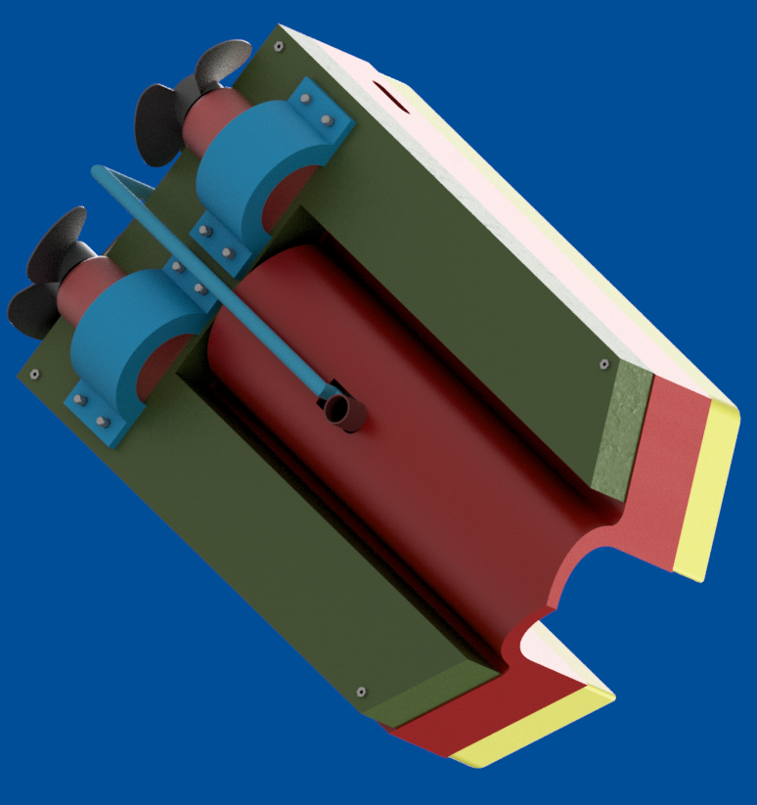
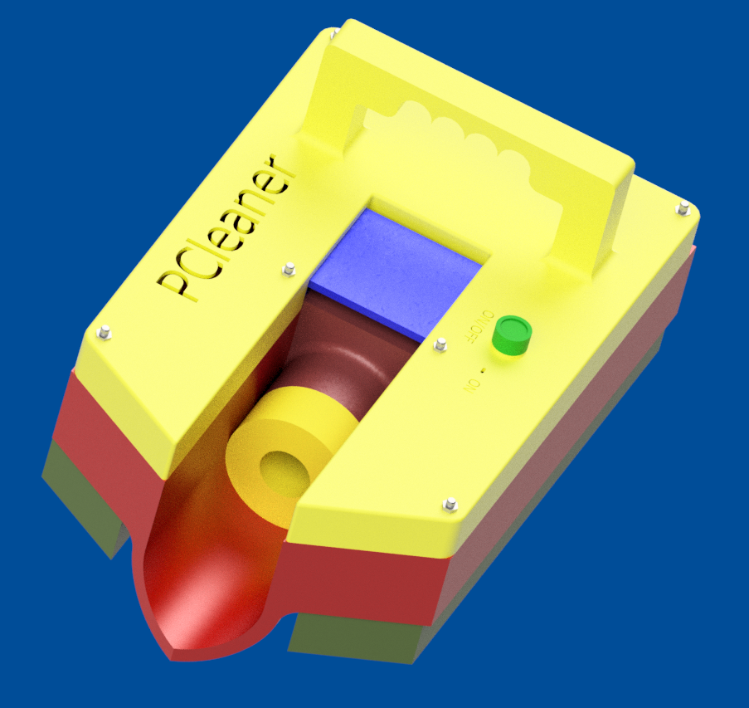
Mechanical Design
CAD Model

Slide 6
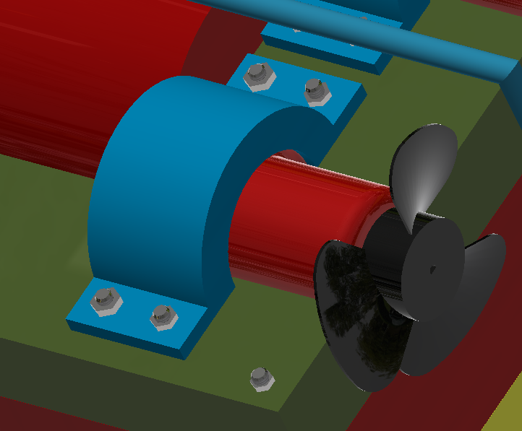
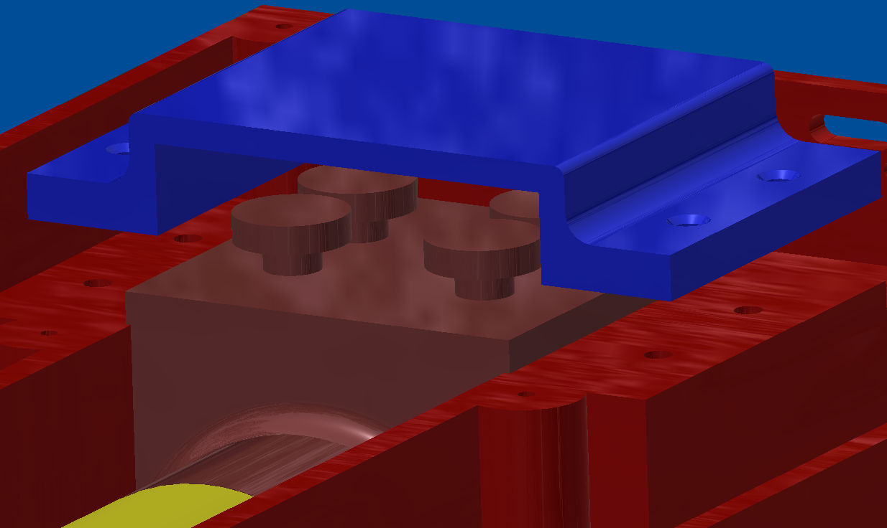
Mechanical Design
Filter and thrusters fixation

Slide 7
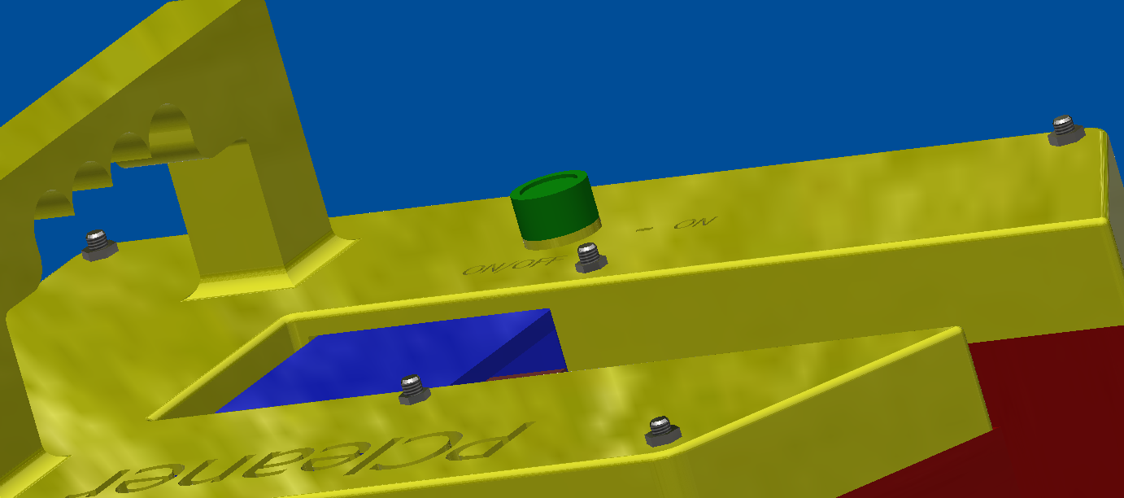
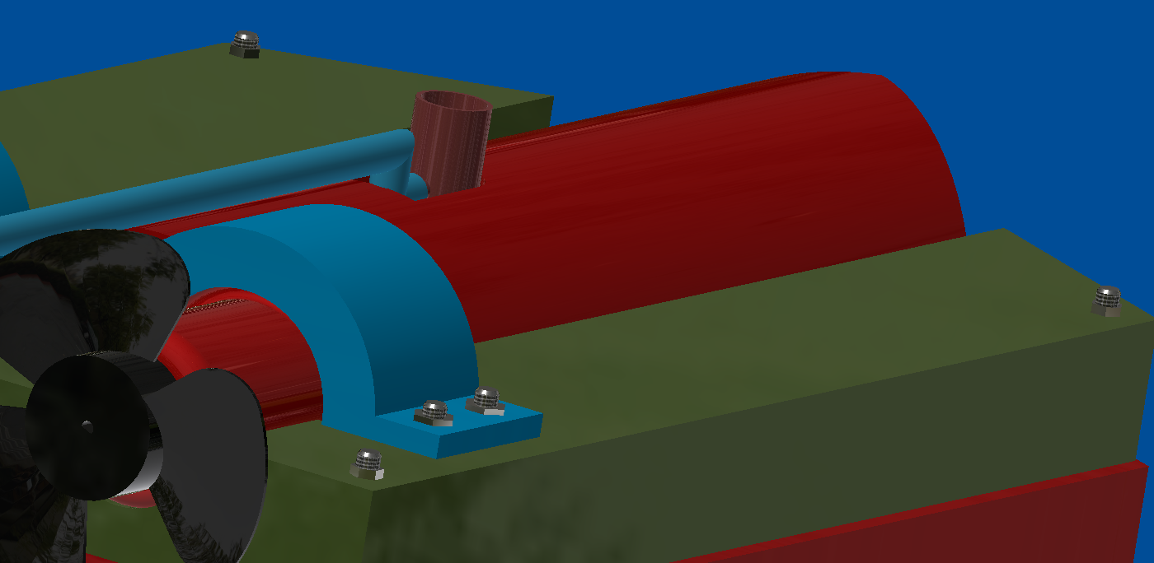
Mechanical Design
Top and bottom fixations

Slide 8
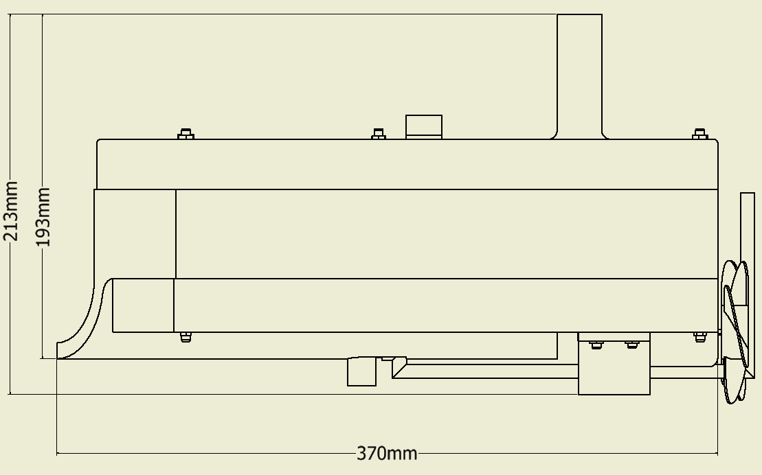
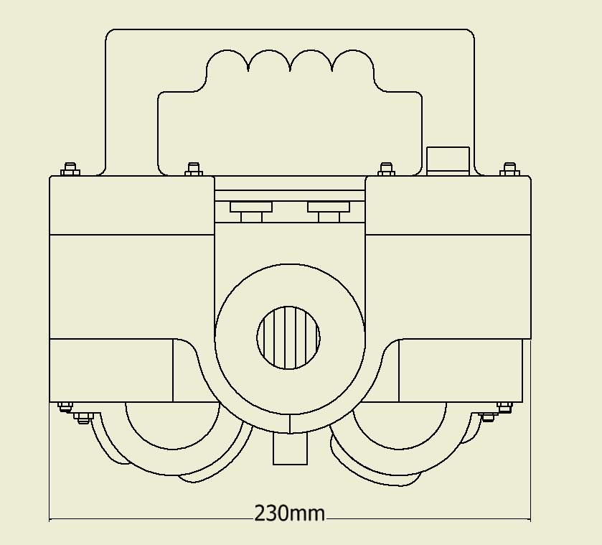
Mechanical Design
Over all dimension

Slide 9
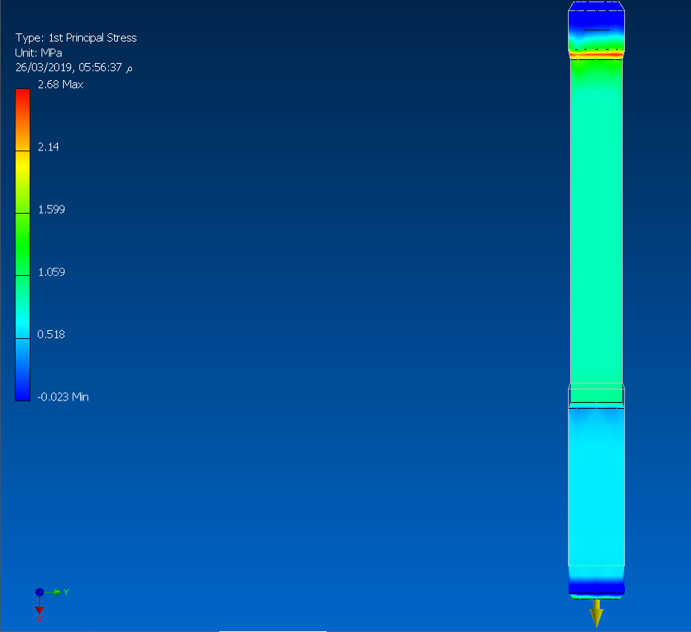
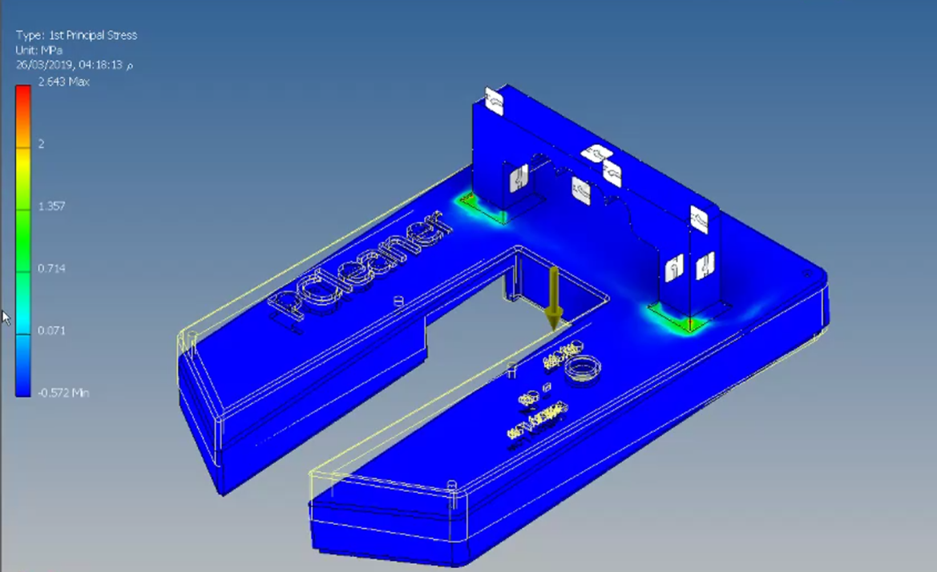
Mechanical Design
Stress analysis on chassis and bolts

Slide 10
Actuator Sizing
Available thrusters are just too big for our application
Replacing a centrifugal pump impeller with a propeller is a solution
Assuming maximum velocity = 0.2m/s < 1km/h and drag force = 0.32N
Suitable pumps required for each thruster of flow rate of 55.5 l/min
Suitable pumps available were of flow rate of 63 l/min
Those pumps with propellers of about 73 mm, together, provided a thrust of 0.462 N
Resulted in a theoretical maximum velocity of 0.42 m/s = 1.5 km/h

Slide 11
Actuator Sizing
MAT Lab Model

Slide 12
Stability
To achieve equilibrium while robot is in positive buoyancy, it has been found that the maximum mass robot can tolerate without sinking is m_{max} = 3.54 kg.
To avoid robot toppling due to misalignment of center of gravity and center of buoyancy, a wide volume is left at the front of ship to allow addition of variable weight.

Slide 13
Electrical System
SID

Slide 14
Safety
Since AC is used to power this robot, high level of safety is considered
Ready sealed products are only present in water.
High quality isolated wires.
All Electronic components are separated in a water proof box out of water, that also allowed easy heat dissipation due to great stepping down of voltage.
A water sensor is used to detect if there’s any leakage in the electronic components box.
Also another water sensor is used to assure that even if the start button is pressed but the robot isn’t placed in a suitable level of water, it won’t operate.

Slide 15
Software Architecture
Flow chart

Slide 16
Manufacturing

Slide 17

Estimated Budget
Parts | Quantity | Material | Manufacturing Operation | Cost (L.E)
Upper Thruster holder | 2 | PLA | 3D-Prinitng | 34
Lower Thruster holder | 2 | PLA | 3D-Prinitng | 25
Base | 1 | PLA | 3D-Prinitng | 417
Chassis | 1 | PLA | 3D-Prinitng | 290
Thrusters | 2 | - | - | 900
Filter pump | 1 | - | - | 250
Water Detection Sensor | 2 | - | - | 156
SSR - 25A (Relay) | 1 | - | - | 65
Start UP Button | 1 | - | - | 3
MPU 6050 (IMU) | 1 | - | - | 70
USB to Serial | 1 | - | - | 40
Sealed wires | 12 | - | - | 192
PCB | 1 | - | - | 60
Bolts M3 | 18 | - | - | 18
Nuts M3 | 42 | - | - | 42
filter breathing tube | 1 |  |  | 2
 |  |  | Total Budget = | 1990
Total Budget $≅2000 L.E$

Slide 18
Timeline
Tasks / Weeks | Week #1 | Week #2 | Week #3 | Week #4 | Week #5 | Week #6 | Week #7 | Week #8 | Week #9 | Week #10 | Week #11 | Week #12 | Week #13 | Week #14
Design Thinking
Product Design
Mechanical Design
Stress Analysis
Manufacturing Plan
Manufacturing
Hardware System
Full System Integration
Paper Work

